Slide 1

Overtime Online Approval Time & Attendance System
System Demo Presentation
Prepared by:
Ervin Olinas Brosas
ICT Department

Slide 2
Agenda:
Introduction to Overtime Online Approval System
Key Features
Current Workflow Setup
Cost Centers List
System Demonstration

Slide 3
Introduction:
The Overtime Online Approval System is:
Paperless online approval of an employee’s overtime
Has built-in workflow that handles the approval process and sending of system notifications to approvers
Provides centralized and real-time data
Web based
In-house developed – no additional license cost

Slide 4
Key Features:
Allows multiple submission of overtime requests as well as approval of assigned overtime requisitions in one go.
Keeps track of all approval and workflow transactions and notifies all persons who have approved the request whenever it’s been rejected or modified by HR.
Authorized users can search for overtime requisitions and data can be filtered by employee no., cost center, current assignee, creator, status, and date period.
Automatic reassignment to the substitute in case the approver is on-leave or business trip.
Automatic escalation to the next approver in the process flow if system checked that a person already approved the request.
Access to the system is controlled and given only to authorized users.
Integrated with other GARMCO systems such as JDE and Access system.

Slide 5
Current Workflow Setup:
Production:
Head of Department / Shift Supervisor
Department Manager
Senior Production Manager
GM Operations
HR Validator
Head of HR
Engineering (Electrical, Mechanical, Utility & Roll Grinding):
Head of Department / Shift Supervisor
Department Manager
Senior Engineering Manager
GM Operations
HR Validator
Head of HR
QC & Lab:
Head of Department / Shift Supervisor
Department Manager
Senior QC Manager
GM Operations
HR Validator
Head of HR

Slide 6
Current Workflow Setup:
Security:
Direct Supervisor
Department Manager
Senior HR & Admin. Manager
HR Validator
Head of HR
Medical:
Department Manager
Senior HR & Admin. Manager
HR Validator
Head of HR
Safety:
Head of Department
Senior HR & Admin. Manager
HR Validator
Head of HR
Stores:
Head of Department
Department Manager
HR Validator
Head of HR

Slide 7
OT Enabled Cost Centers:
Cost Center | Cost Center Name | Company Code | Group Code
2110 | REMELTMELTINGCASTING | 00100 | PRD
2111 | GREENFIELD REMELT EXPANSION | 00100 | PRD
2112 | EMP | 00100 | PRD
3220 | SCALPING | 00100 | PRD
3230 | PREHEATSLABHEATINGFURNACE | 00100 | PRD
3240 | HOTMILL | 00100 | PRD
3250 | ROLLGRINDING | 00100 | ENG
3310 | ANNEALINGCOOLINGBOOTHS | 00100 | PRD
3320 | COLDMILL1 | 00100 | PRD
3322 | COLDMILL2 | 00100 | PRD
3410 | TENSION LEVELLER 1 | 00100 | PRD
3412 | TENSIONLEVELLER2 | 00100 | PRD
3415 | TENSION LEVELLER 3 | 00100 | PRD
3420 | SLITEMBOSS | 00100 | PRD
3430 | CTLRFGUIL | 00100 | PRD
3470 | PACKINGINCLCARPENTRY | 00100 | PRD
3800 | GENERALFACTORY | 00100 | PRD
4100 | QUALITYCONTROLWORKS | 00100 | QC
4200 | LABORATORY | 00100 | QC
5200 | MECHANICALENGINEERING | 00100 | ENG
5300 | ELECTRICALENGINEERING | 00100 | ENG
7150 | ADMINISTRATION SERVICES | 00100 | S&M
7200 | SAFETYSECURITY | 00100 | ADM
7250 | MEDICALSERVICES | 00100 | ADM
7300 | STORES | 00100 | ADM

Slide 8
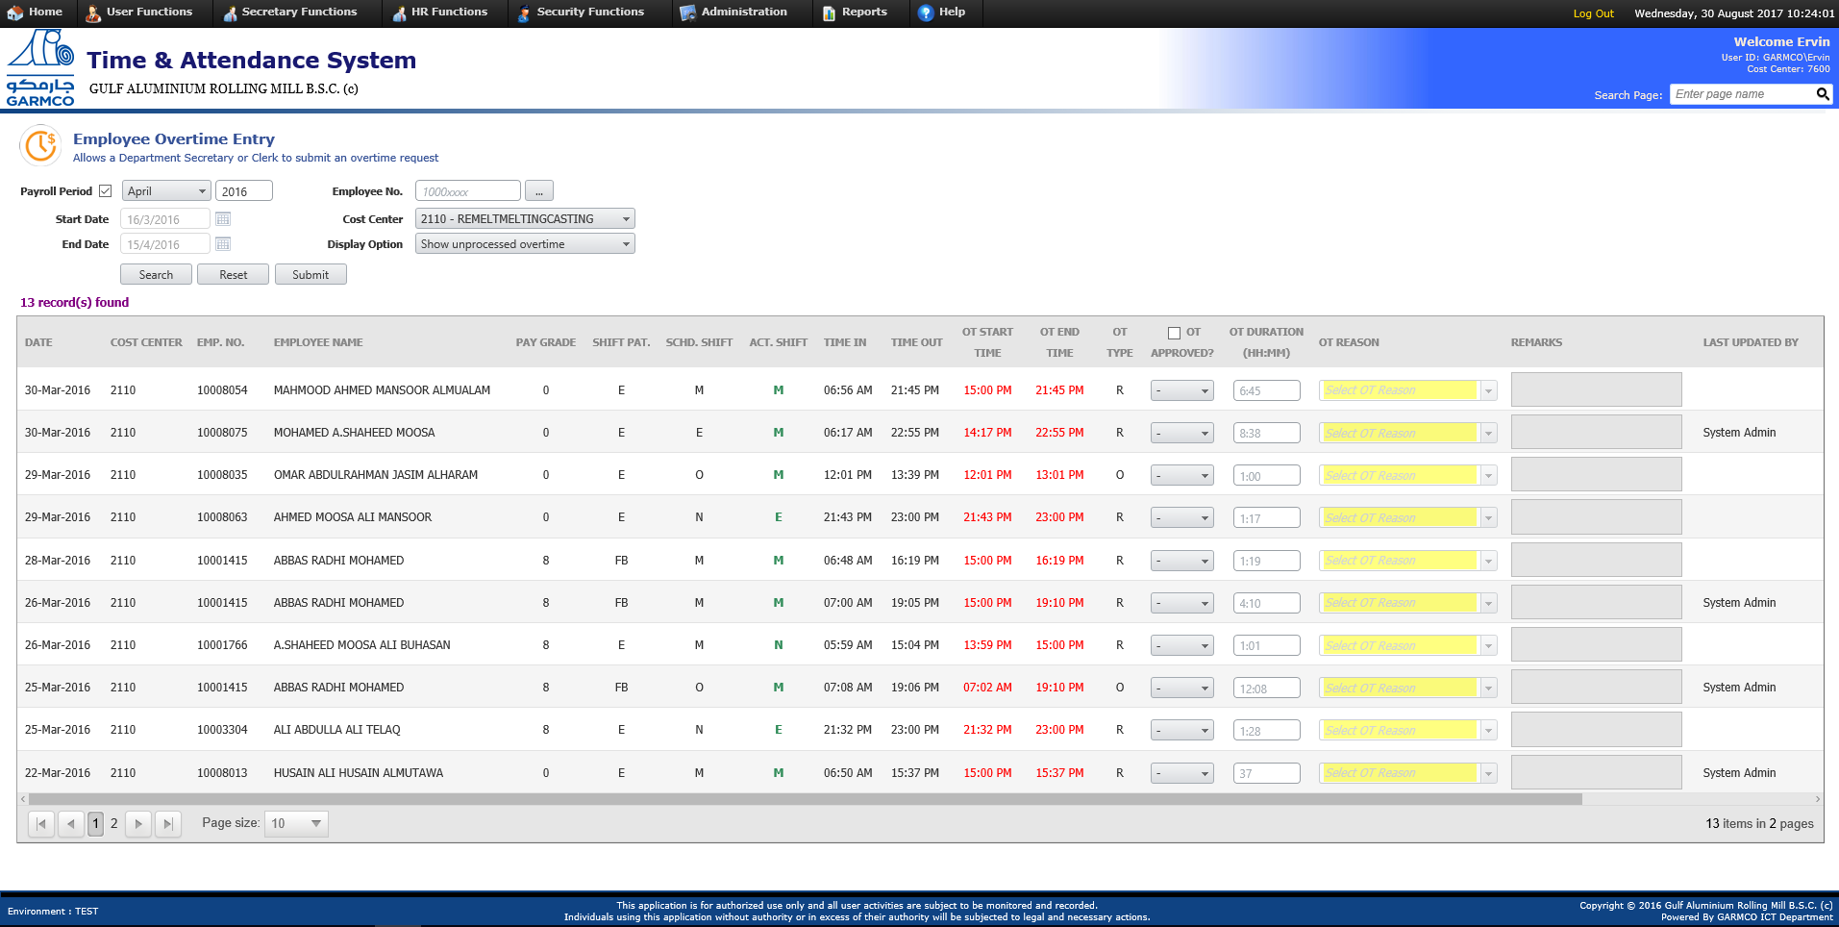
System Demo:

Slide 9
Thank You!

